Slide 1


QCML 06 Lab Session - 1
By Aniket
Indian Institute of Technology Delhi

Slide 2

What we will do today…
Installation Guide
Introduction to Python (Tutorial)
https://www.w3schools.com/python/python_lists.asp
Introduction to Qiskit
IBM Quantum Experience

Slide 3
Five Simple Steps
Step 1: Install Anaconda Navigator
Step 2: Create QCML Environment
Step 3: Install Jupyter Notebook in QCML Env.
Step 4: Open Terminal in QCML Env.
Step 5: Fire five magical commands for Qiskit

Slide 4
Those five magical commands…
pip install qiskit==1.4.3
pip install qiskit-aer==0.14.2
pip install qiskit[visualization]
pip install qiskit-terra==0.45.1
pip install qiskit-ibm-runtime==0.23

Slide 5
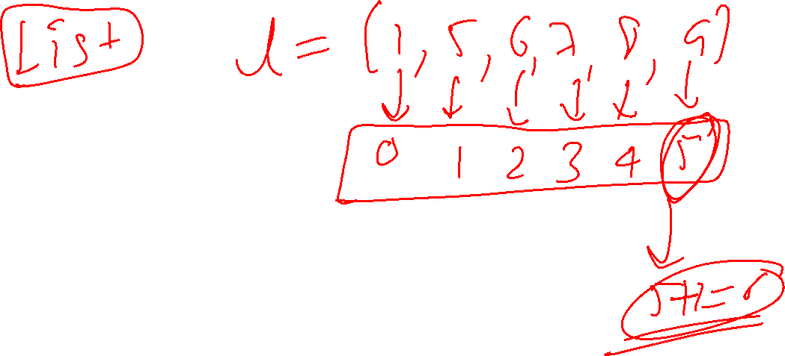

Slide 6
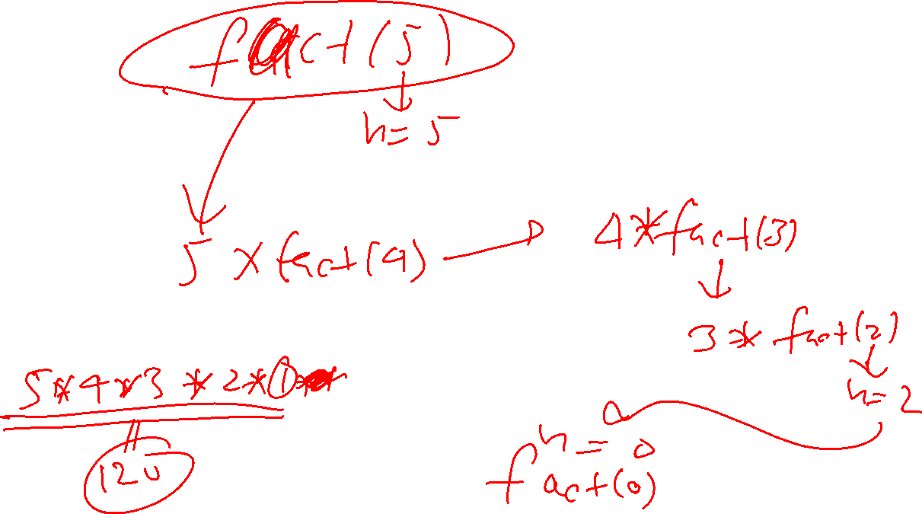

Slide 7
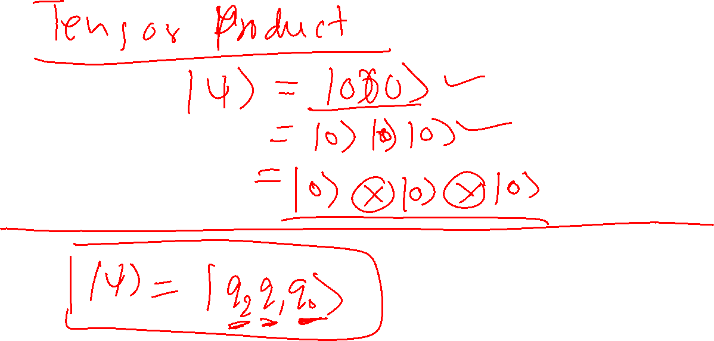

Slide 8
